Slide 1
Favorite website
Presented By Group 4

Slide 2


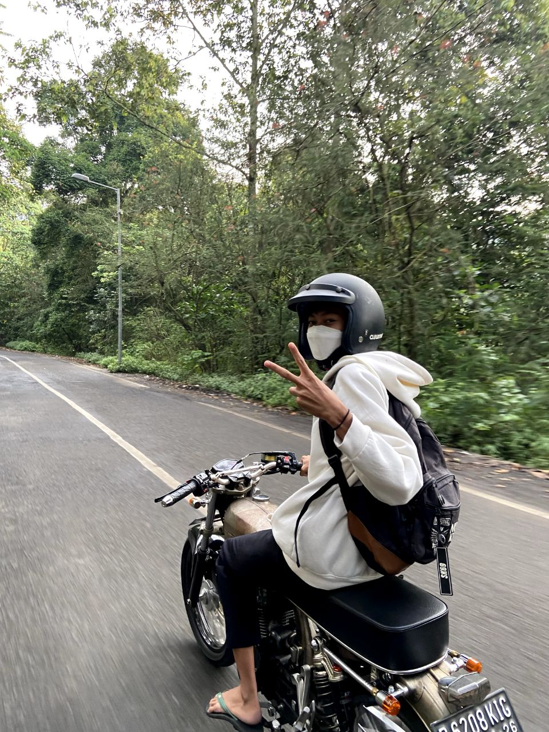
MEMBERS
Afifah
Ivan
Chiko

Slide 3
01
RESPONDENTS
02
WEBSITES
TABLE OF CONTENTS
03
REASON
04
ADVISE
Who are the respondents of this survey?
Respondents favorite website.
Why they visit that website?
Do they have any advise to make the website better?

Slide 4
01
RESPONDENTS
Who are the respondents in this survey?

Slide 5
158 people
GENDER
48,1%
FEMALE
MALE
51,9%

Slide 6
FAVOURITE WEBSITE
02
What is their most favourite website ?

Slide 7
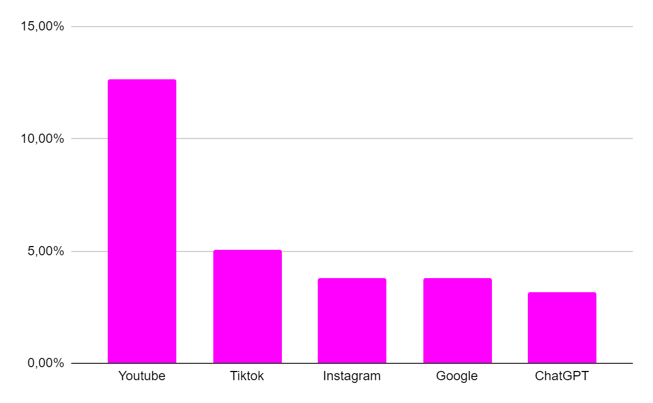
TOP 5 MOST FREQUENTLY VISITED WEBSITE

Slide 8
Why Youtube can be the most visited website?
Useful Video Content
Free and Accessible
Interaction and Sharing
Income Opportunities
Recommendation Algorithm

Slide 9
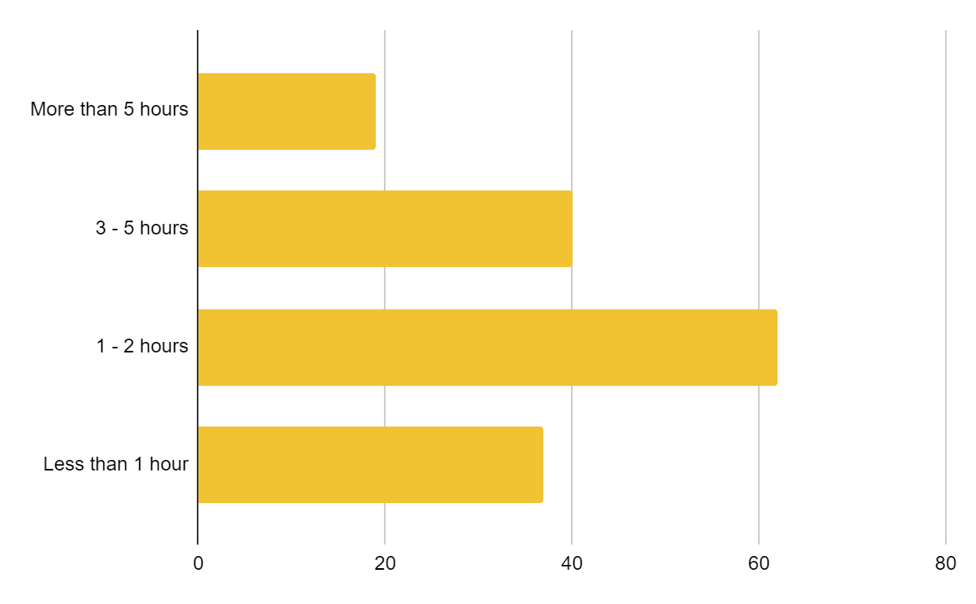
How long they use that websites in a day?

Slide 10
03
REASON TO VISIT WEBSITE
Why they visit that websites?

Slide 11
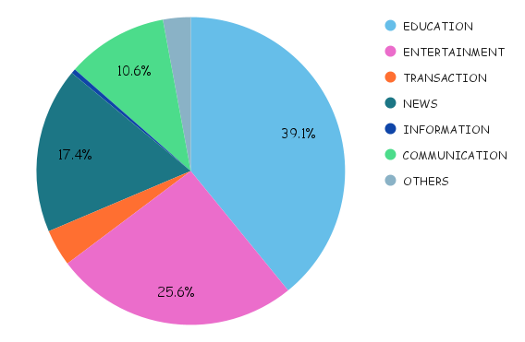
PERSENTASE

Slide 12
ADVISE
04
Do they have any advise to make the website better?

Slide 13
Feedback From Users
1. Reduce Ads.
3. Fix Bugs
2. Update and Expand Content
User want to an ad-free experience or a reduction in intrusive ads.
Users want the developer fix the bugs.
User want the content to be updated.

Slide 14
THANK YOU
Do you have any question?

